Slide 1

UNIT 2: ADVANCED DATA MINING
Mining Multidimensional
Association Rules
Extending traditional mining to complex, multi-attribute insights.
Presented by: Vaishnavi Singh (RA2311003030580)
To: Anirudha Gaikwad

Slide 2
Concept Overview
Beyond Simple Transactions
Traditional Association Rules focus solely on items within a transaction (e.g., {Milk, Bread} → {Butter}). This is limited to "what" is bought.
Multidimensional Association Rules incorporate additional attributes or "dimensions" such as:
•
Demographics (Age, Gender)
•
Geography (Location, Region)
•
Time (Season, Month)
This allows for deeper insights: "Young urban males are likely to buy sports shoes."

Slide 3










Types of Multidimensional Rules
Inter-Dimension
Hybrid-Dimension
Intra-Dimension
Rules implying relationships between different dimensions.
Mixes categorical attributes with item-based transactions.
Captures patterns within the same dimension (e.g., product hierarchy).
Example:
Example:
Example:
(Education=Graduate, Income=High) → (Buys=Luxury Car)
(Age=25-40, Location=USA) → {Smartphone, Laptop}
(Category=Electronics) → (Buys=Laptop, Mouse)

Slide 4
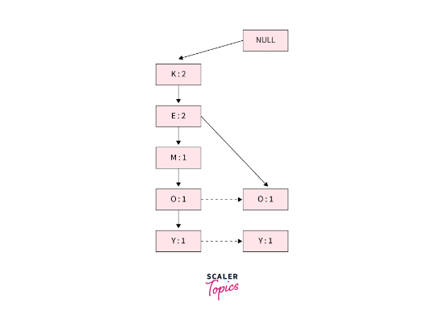
Key Mining Techniques
•
Generalized Apriori Algorithm
Treats categorical attributes as items and prunes infrequent attribute combinations based on minimum support.
•
FP-Growth (Frequent Pattern Growth)
Constructs an FP-Tree for efficient mining without candidate generation. Faster for large datasets.
•
Constraint-Based Mining
Focuses only on rules satisfying specific user criteria (e.g., "Only mine rules for customers aged 18-35").

Slide 5
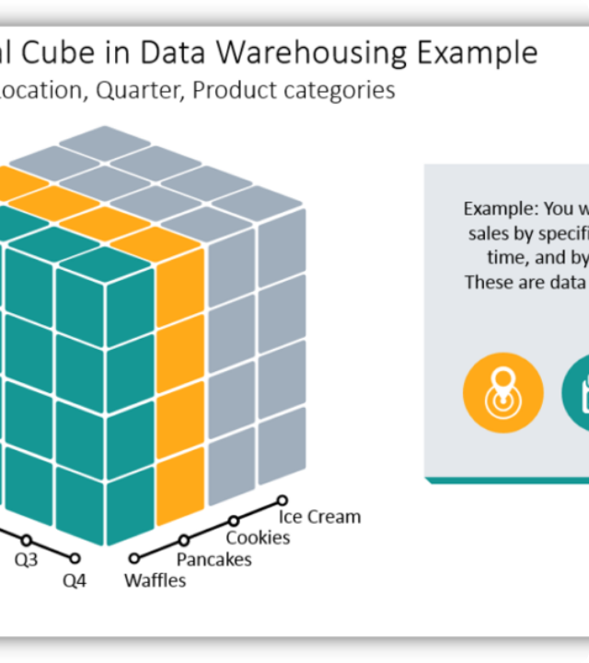
OLAP-Based
Data Cube Approach
Online Analytical Processing (OLAP) cubes store data in multiple dimensions, allowing for efficient Drill-down and Roll-up operations.
Example Dimensions:
•
Time: Daily, Weekly, Monthly
•
Product: Electronics, Clothing
•
Location: USA, Europe, Asia
Drill-down Insight: (Month=Dec, Location=USA) → (Buys=Winter Jackets)

Slide 6
Retail Case Study
ID | Age | Gender | Income | Location | Product Bought
C001 | 25 | Male | Medium | Urban | Bread, Milk
C002 | 32 | Female | High | Suburban | Wine, Cheese
C003 | 40 | Male | High | Urban | Steak, Wine
C004 | 28 | Female | Medium | Rural | Bread, Butter
C005 | 30 | Male | Medium | Urban | Milk, Eggs
Derived Rule: (Age=25-35, Income=Medium, Location=Urban) → (Buys=Milk, Bread)
Strategy: Offer bundle deals for young urban professionals.

Slide 7



Correlation Analysis
Pearson Correlation Coefficient (r)
Correlation measures the relationship between variables to understand dependencies and improve decision-making.
•
Positive Correlation: Direct relationship (+1)
•
Negative Correlation: Inverse relationship (-1)
Chi-Square Test (Categorical)
•
No Correlation: Independent variables (0)

Slide 8




Constraint-Based Mining
To reduce noise and improve relevance, users define constraints to focus mining on specific patterns.
Knowledge Constraints
Data Constraints
Aggregate Constraints
Specific relationships defined by user knowledge.
Based on specific attribute values like price or date.
Based on aggregated functions like sum or count.
"Find associations only between electronic items."
"Find transactions above $100."
"Total price of items > $200."

Slide 9






Market Basket Analysis Metrics
Support
Confidence
Lift
Frequency of itemset in dataset.
Likelihood of B given A.
Strength of association vs independence.
>1: Positive Correlation

Slide 10
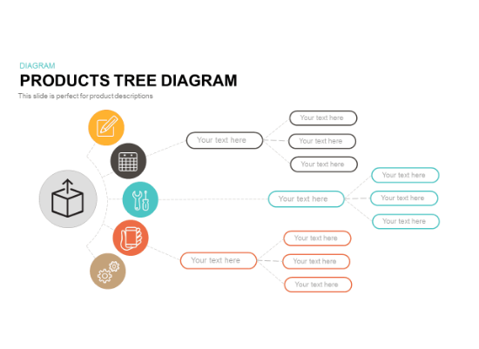
Multilevel Association Rules
Data is often hierarchical. Rules can exist at different levels of abstraction.
•
Level 1 (Category):
{Beverages} → {Snacks}
•
Level 2 (Subcategory):
{Carbonated Drinks} → {Chips}
•
Level 3 (Item):
{Coca-Cola} → {Lays Classic}
Mining at multiple levels ensures no important patterns are missed (e.g., broad categories vs. specific brand loyalties).

Slide 11
Questions?
Thank you for your attention.

